Slide 1
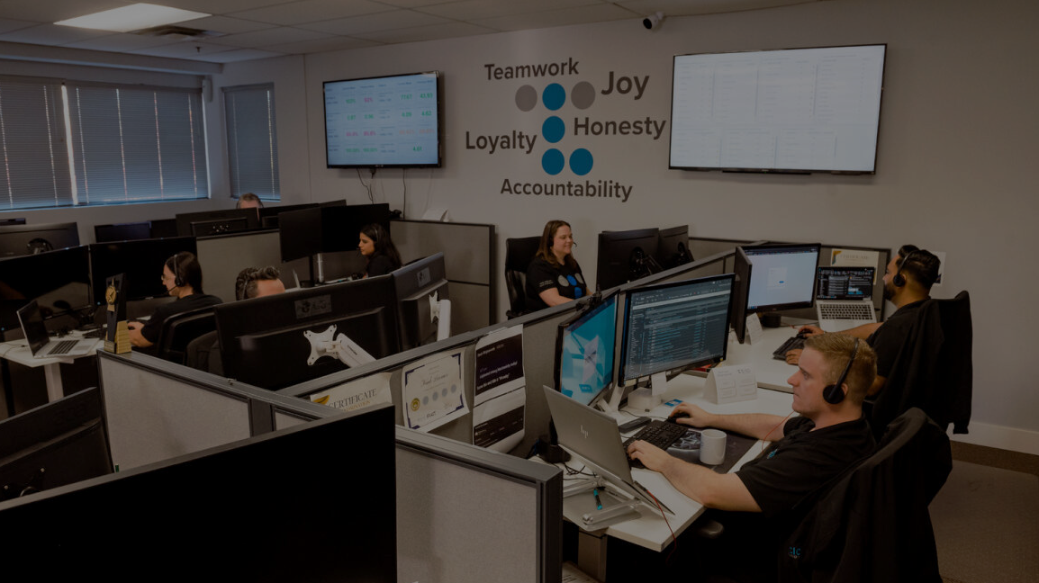
Cybersecurity
Layers of Protection for a Modern Business Technology Ecosystem
Let’s Go!

Slide 2
Attention Span
Number of Slides
Notes:
First thing’s first… I know what you’re thinking…

Slide 3
I want to deliver
technolojoy!
Notes:
I want to deliver you technolojoy.
Fun fact, I had this word trademarked in 2022.
Outside of delivering technolojoy, I want to arm you with some information so that you can take ACTION towards NOT being low-hanging fruit for cyber threat actors (fancy term for the people who are trying to cyberattack your business).

Slide 4



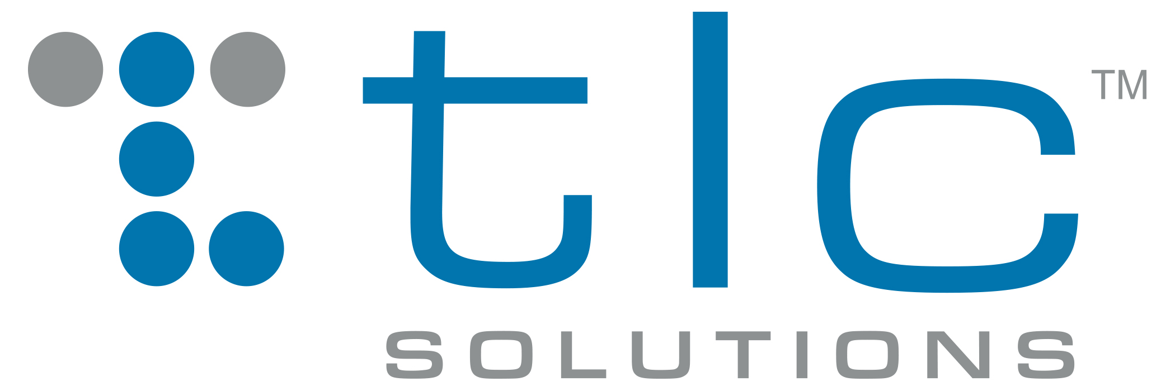
Who the heck is this guy???
Mike Nunn
CEO | TLC Solutions
Chief Technolojoy Officer
Early Career
Comfortable with technology
Small Business
IT on the side of my desk
MSP Value
I knew what I didn’t know, nor wanted to know
Trust the business technology professionals
Not I.T.
Business Technology Solutions
MSP++++
Approachable, fun and relatable tech
Notes:
Go through the slide…
What does this all mean? I have the unique perspective of speaking from both sides; as a company using outsourced business technology services ANDas the person leading a company delivering business technology solutions.

Slide 5




Notes:
I have a dream.
I dream of a day when I don’t need to give this presentation.
When there are no more companies that are low hanging fruit for cyber criminals.

Slide 6


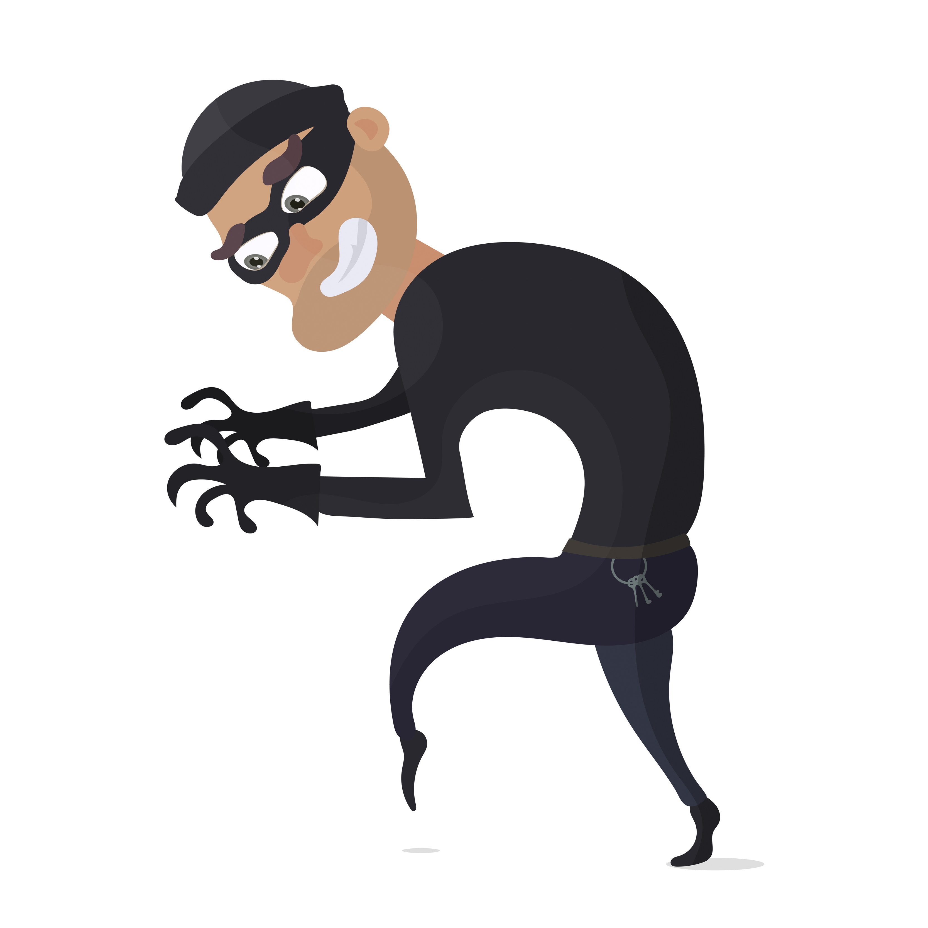
Notes:
Unfortunately… The reality is that there are still too many companies who aren’t adequately protecting themselves from cyberattacks.
I just did an IT assessment for a well-established company and learned they had a server that hadn’t been updated for 4-years and had forwarded ports on their firewall (basically an open door for cyber threat actors when coupled with their un-updated server). I share this because sometimes you can be low-hanging fruit and not know it.
It starts with awareness – and the goal of my presentation is to arm you with information, so your cyber awareness is increased.
Out of curiosity, how many people here work for a company that’s been cyberattacked?

Slide 7
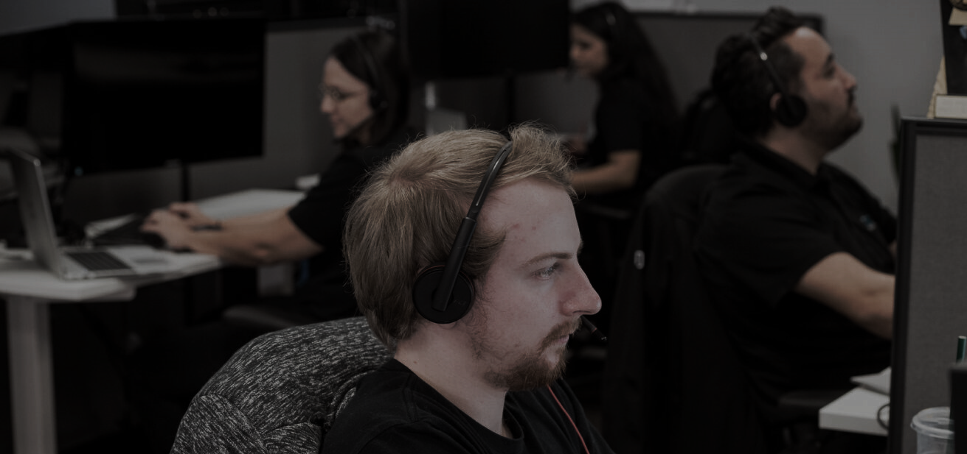
WHAT THE FACT!?!
What the fact!?
Source: EMBROKER
Notes:
Let’s dive in and start with some facts you should know.

Slide 8

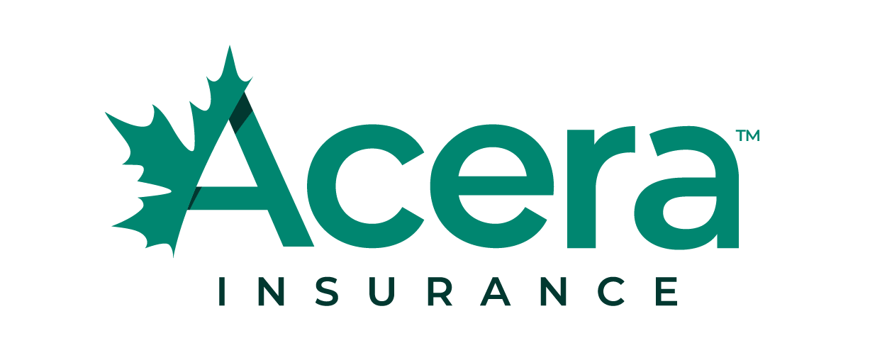
Rob Shearar
National Manufacturing Practice Leader
Notes:
Let me introduce you to Rob Shearar.
Rob and I sit on the board of the BC division of the Canadian Manufacturers & Exporters together, and he shared a couple startling cybersecurity stats with me…
Rob deals with cyber insurance and cyber attack situations all the time as part of his role with Acera Insurance.
Show of hands: How many people here have cyber insurance for their business?

Slide 9
47%
of Canadian SMBs don’t allocate any of their operating budget to cybersecurity
Source: Insurance Bureau of Canada

Slide 10
41%
of Canadian SMBs that suffered a cyberattack reported that it cost them at least $100,000.
Source: Insurance Bureau of Canada
Notes:
These are significant stats because of the extreme and sometimes business-ending impact that a cyberattack can have.
Let me share a few more facts with you…

Slide 11

57% of owners had no cybersecurity training
53% couldn’t spare the cost of adopting innovative new cybersecurity
51% said their firm uses two-factor or multifactor authentication to protect logins
Only 16% were very confident they knew the best steps to take after a successful cyber attack
Only 18% of owners were confident their business would fully recover if an attack happened in the next six months.
Notes:
As part of cyber awareness month in 2023 (October), Mastercard did an online survey of Canadian small business owners. The results are alarming.

Slide 12
43%
of cyberattacks are aimed at small business. Only 14% are prepared. *Accenture
$1,920,000
Average cost to remedy a ransomware hit for Canadian companies. *comparitech.com
90%
Average reduction in financial impact of individual cybersecurity incidents through cybersecurity mesh architecture. *Gartner
>$250,000
Nearly 1/3 of ransomware payments. *Blakes Cybersecurity Report
Notes:
“My business is too small, I’m not going to be on a cyber criminal’s radar.” Not true! SMBs are a big target because there’s a higher likelihood of SMBs not having the proper layers of protection, thus, easier to get money from.
Cyber mesh architecture: a composable and scalable approach to extending security controls, even to widely distributed assets. Its flexibility is especially suitable for increasingly modular approaches consistent with hybrid multi-cloud architectures.

Slide 13
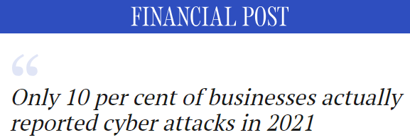
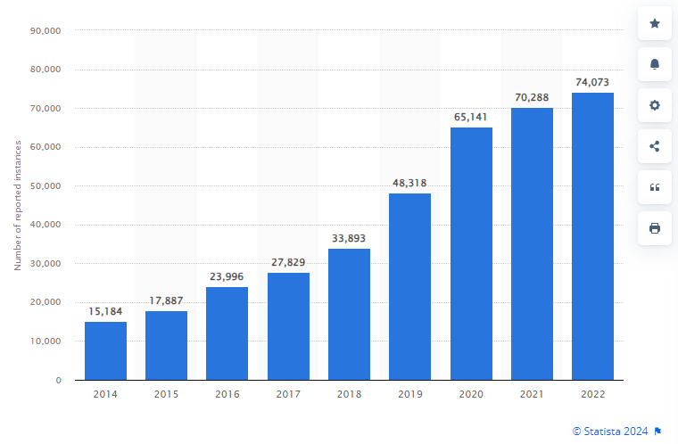

Notes:
We’re
Another unfortunate reality of cyber attacks is that the VAST majority of attacks are not reported.
Companies want to do everything they can to protect their credibility and generally don’t want to publicly share they’ve been attacked, lost data, lost money, or worse.
The result is we only hear about the big companies being attacked and/or if the attack may affect the general public.
going to use these numbers to do a little cybersecurity math.

Slide 14



70,000 reported attacks (10%)
700,000 attacks (43% at SMBs)
301,000 SMB attacks
~ 1,200,000 SMBs in Canada
1 in 4 SMBs attacked in Canada
Notes:
Let’s do some 2021 cyber math…
10% of cyberattacks reported… 70,000 in 2021… 43% aimed at SMBs… Let’s do some 2021 math:
700,000 attacks
301,000 SMB attacks
1.23MM SMBs in Canada in 2021 (Google Search > Stats Canada)
1 out of every 4 SMBs experienced a cyberattack!!!
I can assure you that the number of SMBs is NOT increasing at the rate of cyber crime growth.
Show of hands: How many people here have suffered a cyber attack? How many people here are connected to a company that suffered a cyber attack?

Slide 15



PHISH
FAIL
HVAC HORROR
BACKUP
BLUNDER
Notes:
HVAC HORROR: Ransomware, HVAC Supplier, Accessed Network, Encrypted data, $500,000 Payment – SEGMENTATION
PHISH FAIL: Employee non-profit received a convincing email, supplier asking to change banking details and make payment, large invoices were common so no questions, $250K sent and lost. – EMPLOYEE TRAINING (side note, at a previous company I worked for, this same thing happened: luckily, the Controller did a last-minute check with the CEO, who stopped the transfer.)
BACKUP BLUNDER: Ransomware attack, data encrypted, large operation, had backups but not tested, critical data not part of backups, significant downtime and data loss, +12 weeks of remediation that comes with large support costs. – Regular testing a checking of BACKUPS

Slide 16

AND THAT…
IS A GLIMPSE INTO THE REALITY OF CYBERSECURITY
Notes:
SHOULD BE HALFWAY DONE BY NOW – WATCH TIME.
It’s not IF you will be cyber attacked, it’s WHEN.
So… What can you do?
I want to share a few of the layers of protection you can/should put in place. Please keep in mind these are only a small dose of a full and unified approach to cybersecurity.
If you’ve got these things in place – Awesome! Thank you!
If you don’t have these things – Talk to your IT person, your current MSP, or come see me after the presentation.
Now… There are many layers to healthy cyber hygiene, and I’m only going to have time to cover a few today.

Slide 17

Notes:
Name that movie!
Anyone remember this character’s name? The movie?
Training… All the tools in the cybersecurity arsenal won’t stop a wrong or uneducated click…
Who here had to train, study, and/or practice to get to where you are in your career?
Show of hands: Who here is currently receiving cybersecurity training?
Interesting… With a skill that could save your company hundreds of thousands of dollars, I find it fascinating why more companies don’t invest in cybersecurity training. FYI, most cyber insurance providers require cyber training.
Moreover, next slide…

Slide 18

TRAINING
YOU, not your antivirus program or IT team, are the front line of defense against cyber attacks.
Notes:
Cybersecurity training can cost your business +/- $5 per user/month.
For a 50-person business, this equates to $250 per month or $3000 per year.
Isn’t $3000/year worth the protection against a +$100,000 cyberattack??

Slide 19
MOR CYBER HYGIENE LAYERS
Cybersecurity training can cost your business +/- $5 per user/month.
For a 50-person business, this equates to $250 per month or $3000 per year.
Isn’t $3000/year worth the protection against a +$100,000 cyberattack??

Slide 20
TRAINING
Verify sender’s email
The name may be correct, but the email could be different. Check the username and domain carefully; one character matters.
Examine email contents
Is the email generically addressed? How’s the spelling and grammar? Is there a name of a person it’s from?
Other things to watch for: urgency (need it now), private information request or change (banking details), gift card purchase.
Reach out
DON’T HIT REPLY – Call the person/company or send your own email using the contact info YOU have on file.
Inspect the links
Hover your mouse over links/hyperlinks to see the actual URL - If it’s unrelated to the email content, don’t click it.
Filter and block
With every suspicious email that gets reported to your system/email administrator, cyber hygiene improves.
Yeet to trash!
Keep your cybersecurity antenna up and quickly delete emails if there’s any doubt.
Notes:
Email is one of the most common ways for a cyber criminals to target businesses.
All it takes is a clicked link, opened attachment, or scanned QR code and a cyber criminal is in the door.
Please remember this when it comes to email cyber hygiene: VERIFY – Verify your email!

Slide 21
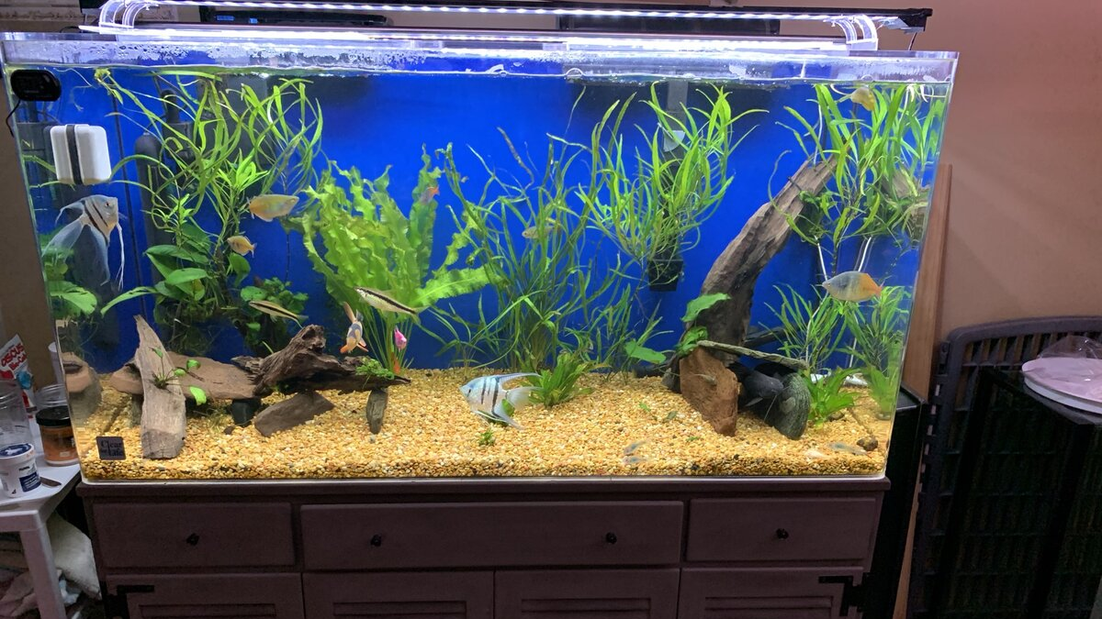
Notes:
How many people had one of these in their home growing up?
How many people have one in their home now?
Let me tell you about segmentation…If it’s connected to the Internet and your network, it’s a door for cyber criminals to try break through
I’m going to use fish tanks as an example. The tank represents your network, and everything in the tank represents the devices on the network. One problem can take out the entire network.
If the filter dies, everything can go down in the tank. Downtime.
If a contaminant gets into the tank, it can affect or kill all the fish.
Maintaining and protecting large networks requires complex skill sets and resources
This is how many business’ networks are built.
Instead of one big network, it’s important to consider :
- Production is separated from main office networks
- Different buildings/locations/even departments are segmented
- Suppliers don’t have direct access
- Guest and Wi-Fi access
Remember that example I shared of a company being attacked through their HVAC supplier? They weren’t segmented.
Any device connected to your network and the internet is a potential way in for cyber criminals.
Segmentation is a layer that prevents the cyber threat actor from affecting everything by breaking your network down into segments, thus isolating threats/attacks.

Slide 22
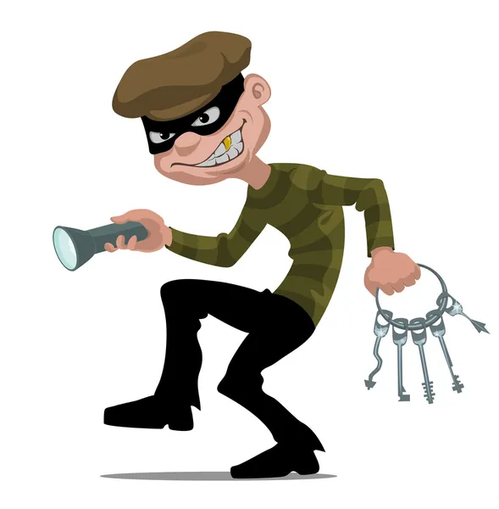
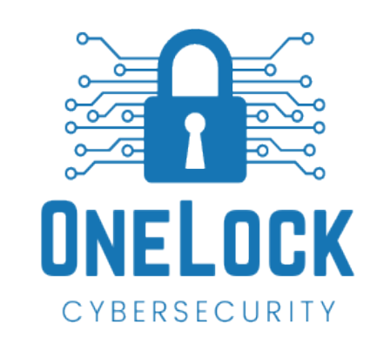

?
Antivirus
Notes:
Antivirus
Top-grade cybersecurity tools (MDR) will cost your business $15-$20 per user/month.
For a 30-person business, this equates to $450-$600 per month or $5400-$7200 per year.
Even at $7200/year, isn’t the protection against a +$100,000 cyberattack worth it??

Slide 23



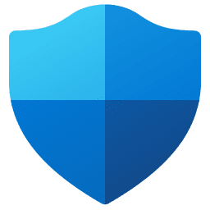



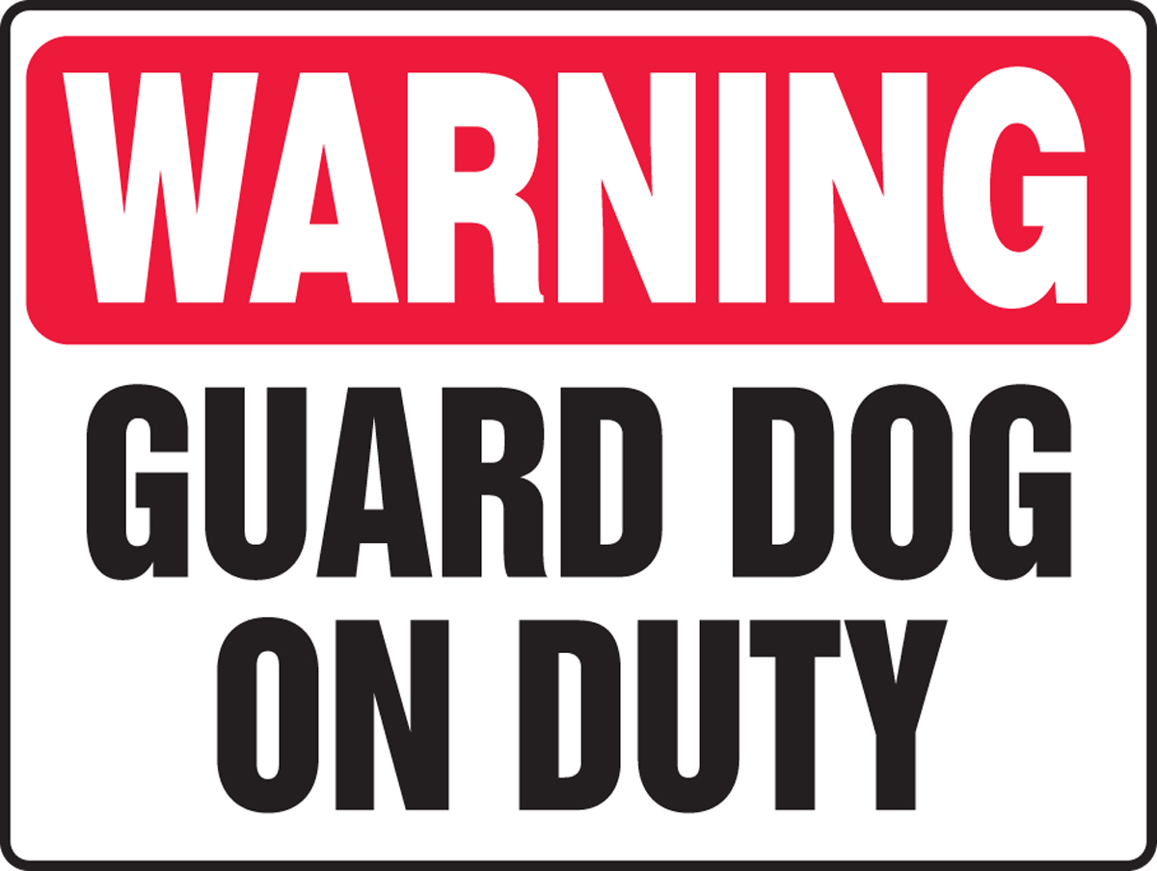
1
2
3
4
Notes:
Analogy: protecting your home.
Open door, aka nothing
At one end of the spectrum you’ve got a dog guarding your house. That dog is hopefully going to do the best it can to bark and scare away anyone who it doesn’t know or tries to force their way in. But the would-be robber only has one piece of threat resistance to deal with, and may be able to trick or subdue the dog.
Next you’ve still got the dog, and you also have one of those home camera/alert systems that you can set up to send you an alert or notification when a certain event is triggered based on time or motion areas. It’s better at detecting threats, but these can send you many alerts and you may develop alert fatigue. I don’t know about you, but they seem to always send notifications in the middle of important meetings. I know, I’ve got a Ring doorbell that does this.
Lastly, you’ve got an alarm system with multiple trigger points or doors and windows, sirens, monitored by real people, and backed by local police response when threats are verified. AND, products like TLC’s OneLock protects your cloud software, and Android/iPhone devices.
Which house would you feel safer living in?
Raise your hand if you prefer 1? How about 2? 3? 4?
1 is symbolic of having nothing or infrastructure/methods that haven’t been updated for years.
2 is like having an old or outdated antivirus: Scan, detect, delete (hopefully). Won’t stop phishing.
3 represents the EDR/XDR platforms. It’s being monitored, but by whom? And do they have the tools/skills to deal with the threat?
4 represents a managed platform like MDR. There’s proactive and trained human monitoring and it’s clear to any threat actor this house is not low-hanging fruit. Moreover, this level of protection includes your cloud platforms and mobile devices.

Slide 24
MOR CYBER HYGIENE LAYERS
Top-grade cybersecurity tools (MDR) will cost your business $15-$20 per user/month.
For a 50-person business, this equates to $750-$1,000 per month or $9,000-$12,000 per year.
Even at $12,000/year, isn’t the protection against a +$100,000 cyberattack worth it??

Slide 25

Notes:
Has anyone ever tightrope walked?
How many people would walk a tightrope without a safety net?
Backups - The safety net to ensure you can recover from a cyber attack as quickly as possible.
Every day you’re walking that tightrope of business. Cyberattacks are like the winds and gravity attempting to take you off the rope. That balance pole is your current cyber hygiene and it’s the only thing giving you a shot at moving forward, and you don’t want to be one of the crazy few who attempts this without the balance pole.
Remote backups, on-site backups, and/or a combination of both.
Show of hands: How many people here have backups in their business?
How many people KNOW the backups are tested and working properly?
How many people KNOW the data being backed up is the right/needed critical business continuity data?
Should you suffer a cyber attack, and as I’ve shared already it’s a matter of when not if, don’t you want to know that your backups are working as they’re supposed to and protecting the business-critical data? This isn’t micromanaging your team; it’s just being certain and having peace of mind.
**Backup as a Safety Net:**
1. **Tightrope Walker (Business Operations):**
- Imagine a tightrope walker performing high above the ground, representing the delicate balance of business operations. The tightrope walker relies on stability and precision, just as a business relies on its data for smooth operations.
2. **Safety Net (Data Backup):**
- Below the tightrope walker, there's a safety net in place to catch them in case of a misstep or fall. Similarly, a data backup acts as a safety net for businesses, ready to catch and restore crucial information in the event of data loss, corruption, or system failure.
3. **Balance Pole (Original Data):**
- The balance pole held by the tightrope walker symbolizes the primary data used to navigate and sustain business operations. It's the key tool for maintaining balance and ensuring a successful performance.
4. **Safety Net Installation Crew (Backup System):**
- The installation crew responsible for setting up the safety net represents the process of implementing a robust backup system. This crew ensures that the safety net is in place and ready to provide support when needed.
5. **Windy Conditions (Data Risks):**
- Windy conditions or unexpected challenges represent the risks to business data, such as cyber threats, hardware failures, or human errors. These conditions can destabilize the tightrope walker (business operations) and necessitate the use of the safety net (backup).
6. **Confidence in Performance (Risk Mitigation):**
- With the safety net securely in place, the tightrope walker can perform with confidence, knowing that there's a backup plan for unexpected situations. Similarly, businesses can operate with confidence, knowing that data backups mitigate the risks associated with potential data loss or disruptions.
In this analogy, the safety net serves as a reliable backup system, offering a sense of security and allowing businesses to navigate the challenges of their operations with confidence.

Slide 26
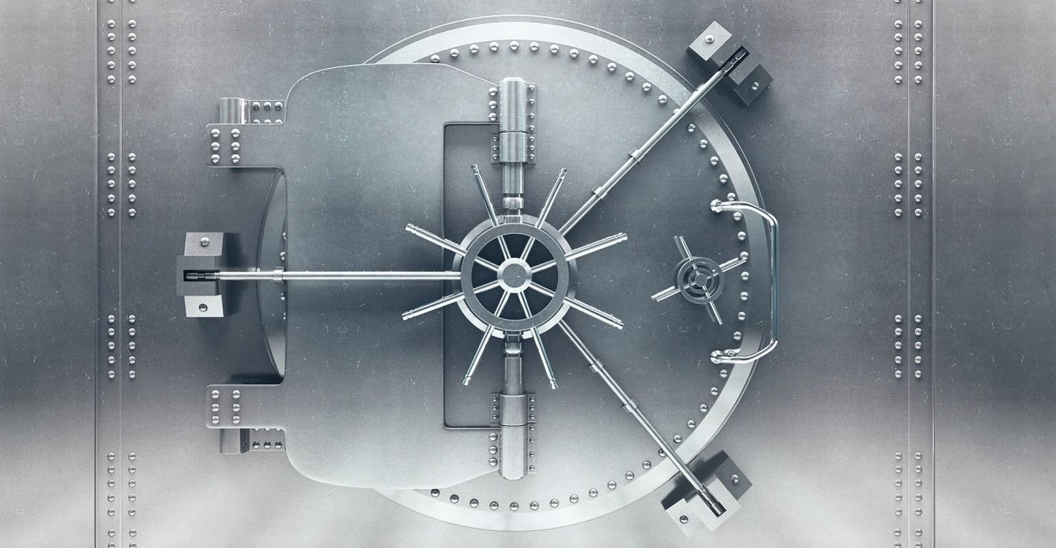
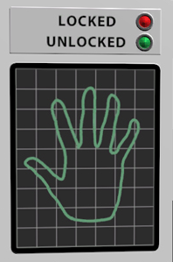
Notes:
Multi-Factor Authentication – MFA
Two-Factor Authentication - TFA
The safe… The code to the lock… This is life without MFA.
We do our best to have a great PW… We do our best to keep our PWs safe…
However, the world of brute force attacks assisted by AI, recycled/reused/never-changed PWs, and social engineering exists.
MFA is the added layer of protection, unique to you, is an essential cybersecurity layer of protection.
Yes, it adds a step to logging in. Yes, it can slow you down a bit. And it’s worth it.

Slide 27
MOR CYBER HYGIENE LAYERS
Cyber Insurance, compliance & pen testing
Operating system updates & patching
Hardware replacement/modernization
Password management
Permission control/access & user groups
Onboarding/offboarding procedures
Supplier checks and balances
And the list goes on…

Slide 28


Notes:
Yes, putting in a business technology stack and infrastructure can be expensive, especially if it’s been neglected over the years.
Moreover, our team at TLC sees this too often… Rather than properly fixing/correcting a company’s IT/network/infrastructure/cybersecurity issues, there is a tendency to go with the band aid IT solutions because a lot of time they’re faster and cheaper solutions. Unfortunately, these typically lead to the elephant in the room of compounding business technology infrastructure problems (slowness, increased troubleshooting, and weak cyber hygiene.
I think we all know how the saying goes for eating an elephant… One bite at a time.
The same goes for correcting your business technology… A budget and plan can be built with the most urgent issues addressed first, executed over a period of time that’s a win/win for the business and to maximize protection.
One of the best places to start is with a network assessment. It’s a 2-3 week process that will give you clarity and insights into network and cyber vulnerabilities that can be turned into an action plan. If anyone is interested in exploring this, please come see me or take a pic of my contact details on the last slide.

Slide 29

Notes:
Like every business, you have a choice.
It starts with knowledge and awareness. I hope that this presentation has armed you with information to make a choice…
Take the blue pill – keep doing what you’re doing, hoping that you can stay under the cyber criminal’s radar, and praying you’re not hit with unexpected data/money/business loss.
Or… Take the red pill and embrace the rapidly evolving world of cyber hygiene – staying on top of trends, layers of protection, and making the investments in NOT being low hanging fruit. Now, I can tell that some of you have already taken the red pill, and that’s awesome.

Slide 30
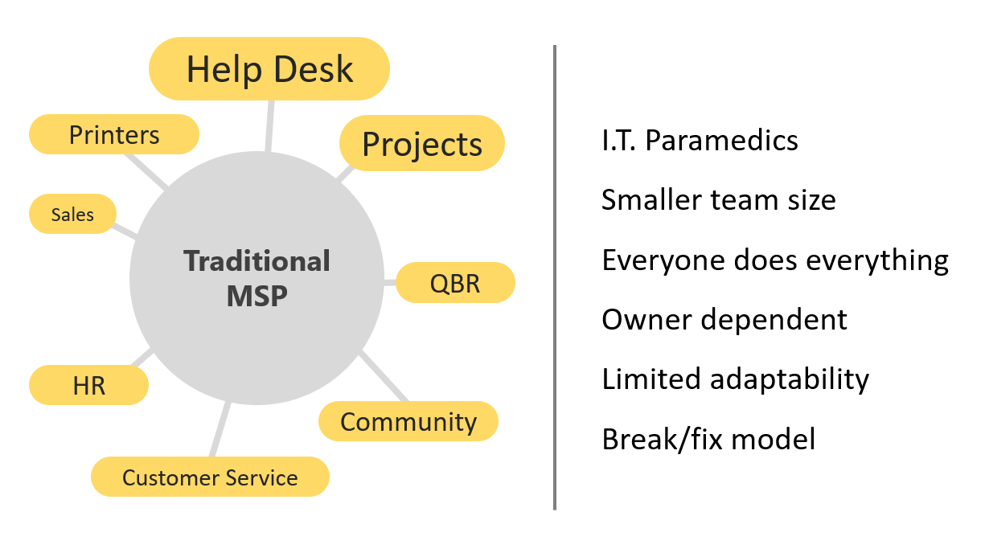

The MSP Approach

Slide 31



TLC Modern Approach
OneHub
ERP
Database
Process Automations
WMS
Consulting
Coding
Help desk
Cybersecurity
Troubleshooting
Day-to-Day
Augmentation
Vendor Support
Remote/On-site
Networking
Managed
Services
Enterprise Software
Cabling
Fibre Optic
TV Mounting
CCTV
Installations
Projects
Onboarding
Cloud
Migrations
Procurement
MFA
Infrastructure
Central Service
Professional Services
Cybersecurity Insurance
Advisory for:
Cybersecurity, Pen Testing, Gap Analysis

Slide 32
WHAT THE FACT!?!
Internal Team
TLC Solutions
PRO
Instant Response
Part of culture
Rapid intimate understanding of your business
CON
Hiring & replacement costs
Vacation coverage
Limited ability for diverse IT experiences
High costs to scale
PRO
Comparable cost to internal team
Dedicated Pod
Augment your existing team
Low cost to scale
Dedicated projects team
CON
Not initially familiar with your industry, company, and jargon
Higher cost for smaller businesses
Notes:
Let’s dive in and start with some facts you should know. Cyber hygiene starts with awareness.
By the way, these are true facts! I’ve got all the sources noted on the slides. ;-)

Slide 33


TLC FOR YOUR BUSINESS
Mike Nunn
CEO | TLC Solutions
Notes:
Talk to your business technology team or provider, put a plan in place.
If anyone would like a fresh take or has questions, by all means please reach out. TLC is here to deliver technolojoy.

