Slide 1
NUTRITION FACTS and
RETAIL LABELLING
Bruce Marshall
Nutrilytical
*this is a summary, and laws can change. Always confirm before printing your packaging.

Slide 2
TIMELINE
How did we get here?
How do I comply?
What’s next?

Slide 3

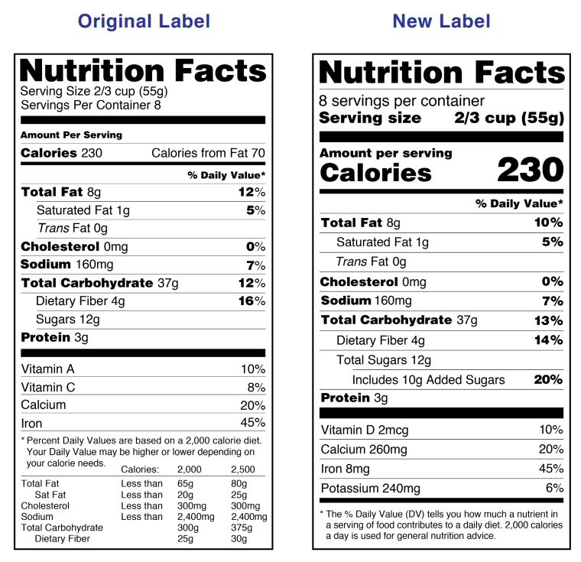
1994-2021: USDA Nutrition Labelling and Education Act

Slide 4
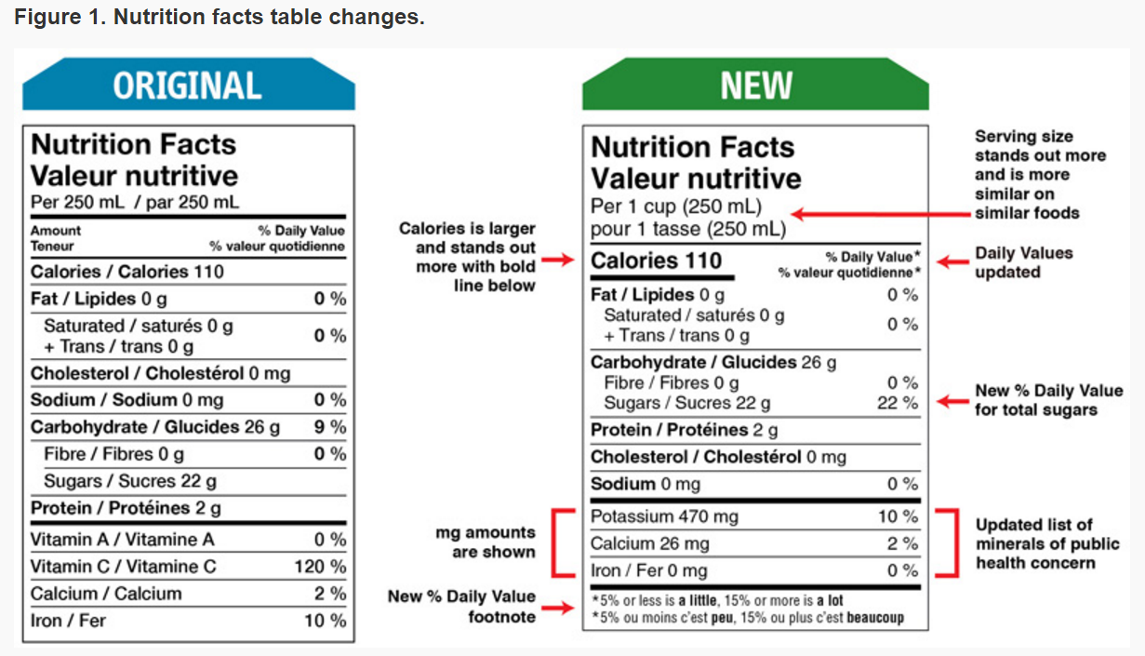
2005-2016: Canada’s Nutrition Facts

Slide 5
What does a retail food package need?
There are a few basic things that all retail food products need
Of course there are exceptions and extras in certain cases!
The “GOLDEN RULE”: don’t mislead the consumer

Slide 6
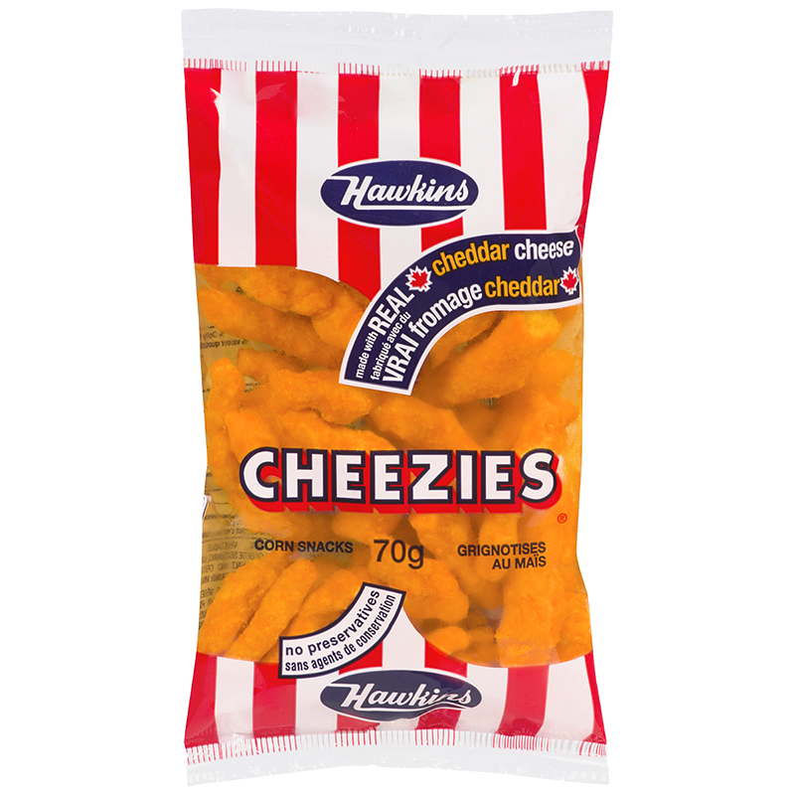
COMMON NAME (always on the main panel)
Tells the consumer what is inside, in plain English (and French)

Slide 7
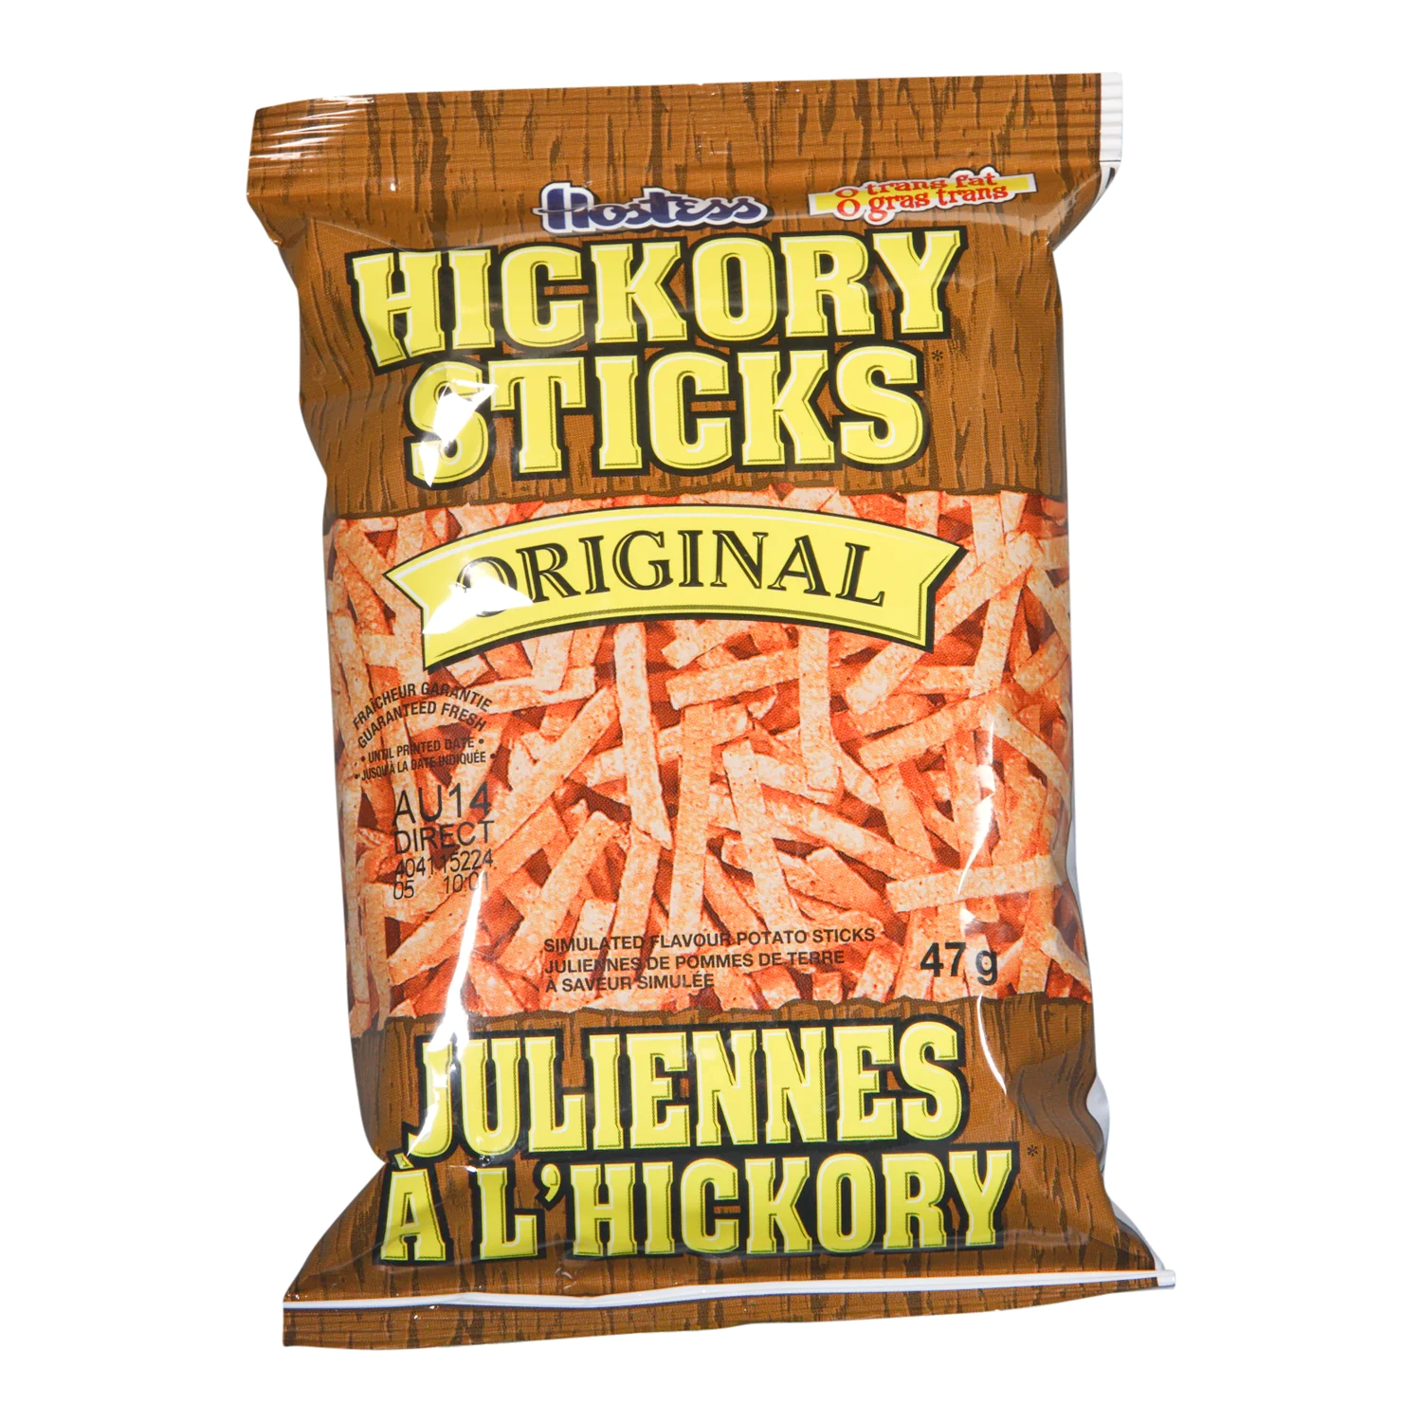
NET WEIGHT (always on the main panel)
At least 1.6mm high numbers
Font increases as the package size does
Always metric, imperial is optional

Slide 8
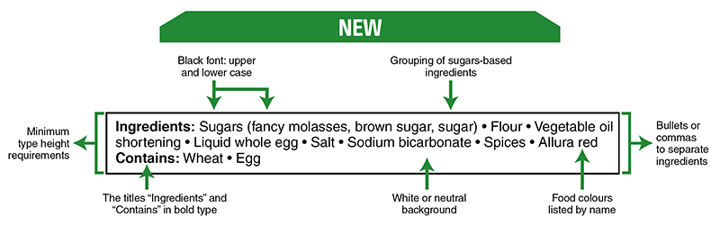
INGREDIENTS
Must use common names for ingredients and list them in descending order by weight.
NEW: Sugars must be grouped together and placed in the list by their total weight.
NEW: Food colours must be declared by name.
Black type on white background, a border is needed if the package around the ingredient list is white. Specific bolding and capitalization as well.

Slide 9
ALLERGENS
You must identify any of the PRIORITY ALLERGENS that are present
Type of Tree Nut, A Gluten Source, Peanut, Sesame, Egg, Milk, Soy, Type of Fish or Shellfish, Mustard, Sulphites.
In the same box as Ingredients, saying “Contains:”

Slide 10
PRECAUTIONARY STATEMENT
Voluntary, alerts to the possibility of cross contamination
“May Contain:” and is also in the Ingredients box.
This is not a way to get around Good Manufacturing Practices (GMP)

Slide 11
NAME and ADDRESS
Has to point to your place of business.
Enough detail for someone to address a letter to you.

Slide 12
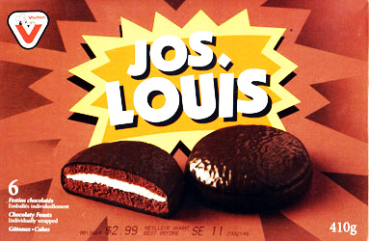
STORAGE and BEST BEFORE
If the product can’t be safely stored at room temperature you need to specify how to store it.
If the product has a “durable life” of less than 90 days you need to declare a Best Before date.
Also a good idea for more than 90 days
to prevent consumers eating something
that tastes stale.

Slide 13
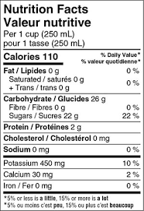
NUTRITION FACTS
Shows 12 core nutrients, plus Calories.
Many other nutrients are optional (but must be there if added or you are claiming something about them)
There is a catalog of defined sizes and formats, that depend on the size of your packaging. Generally you are not forced to use more than 15% of the available display surface.

Slide 14
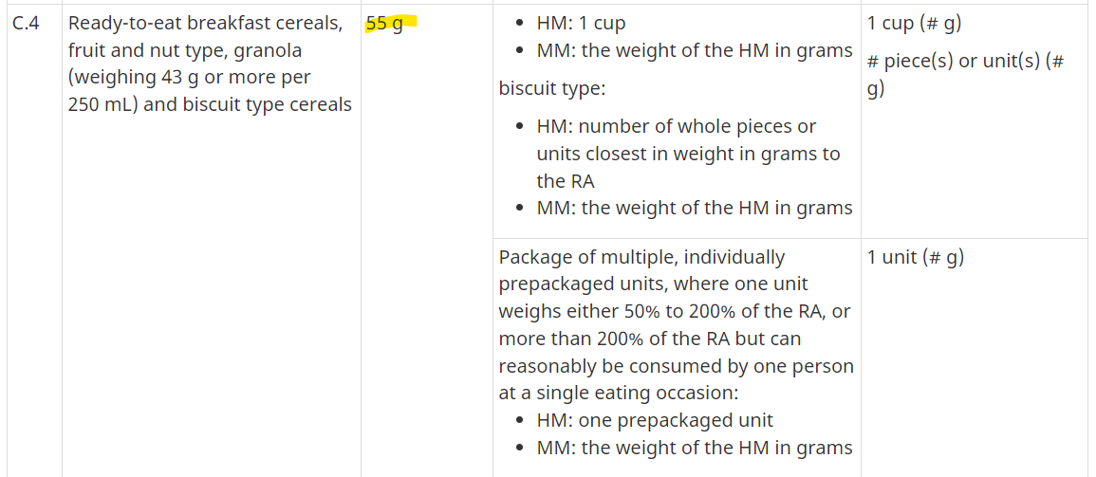
THINGS TO KNOW: NFTs
Most foods have a defined Reference Amount, and specified language when defining and describing a Serving on your package.

Slide 15
THINGS TO KNOW: NFTs
Generally a package that is less than 200% of the Reference Amount is considered a single serving.
Or, if the CFIA determines that the package is being sold as being intended for one person to eat at one sitting.
For example Jerky has a Reference amount of 30g, so generally a 60g package would be 2 servings, but a 59g package would be a single serving.

Slide 16
THINGS TO KNOW: NFTs
If 6 or more nutrients can be declared as “0”, you can shift to a simplified version that eliminates those nutrients (into a footnote that says “not a significant source of…” to save some space.
You can have a second column that shows nutrition as prepared, but always need to show nutrition for “edible material as sold”.
You can have an aggregate format as well (for different flavours of chips in a multipack for example).

Slide 17
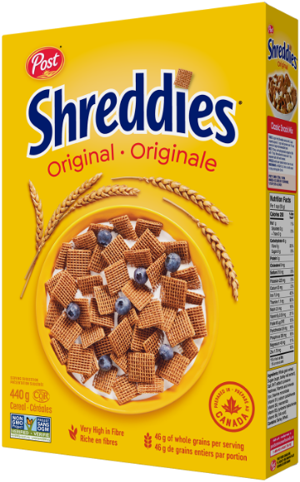
OPTIONS (usually very controlled language)
Nutrient claims: “good source of Iron” “High source of fibre”
Must be true for BOTH the serving size and the reference amount.
Can have “quantitative” declarations, per serving.

Slide 18
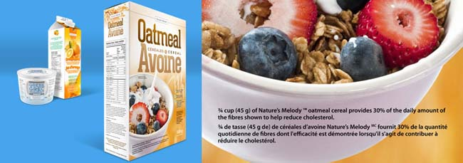
OPTIONS
Nutrient Function (Biological Role) claims
Must be science based, and the nutrient must be at least defined as a “source” (more than 5% Daily Value)

Slide 19
OPTIONS
Health Claims – broader statements linking diet to health
Must be careful not to not market your food as a Drug (Natural Health Product) accidentally.
There is a table of specific relationships and wording, with specific nutritional requirements.
"A healthy diet with adequate calcium and vitamin D, and regular physical activity, help to achieve strong bones and may reduce the risk of osteoporosis. (Naming the food) is a good source of calcium."

Slide 20
OPTIONS
Other claims are allowed, again with strict guidelines.
Healthy - Nutritious - Wholesome – Good For You
Natural - Organic - Non GMO - Made in Canada

Slide 21


Slide 22
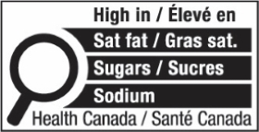
FRONT OF PACK LABELLING

Slide 23
OVERVIEW
Food manufactured after Jan 1 2026 needs to comply, but it is law now.
Highlights foods with high levels of nutrients of public concern:
        Saturated Fats
        Sodium
        Sugars

Slide 24
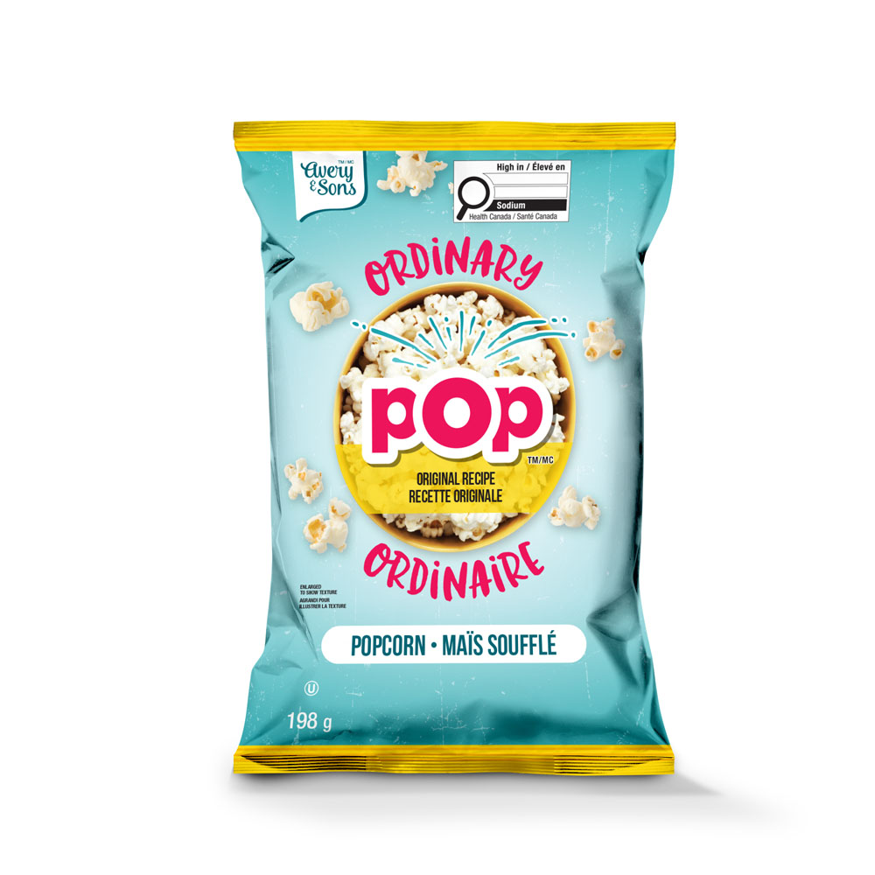
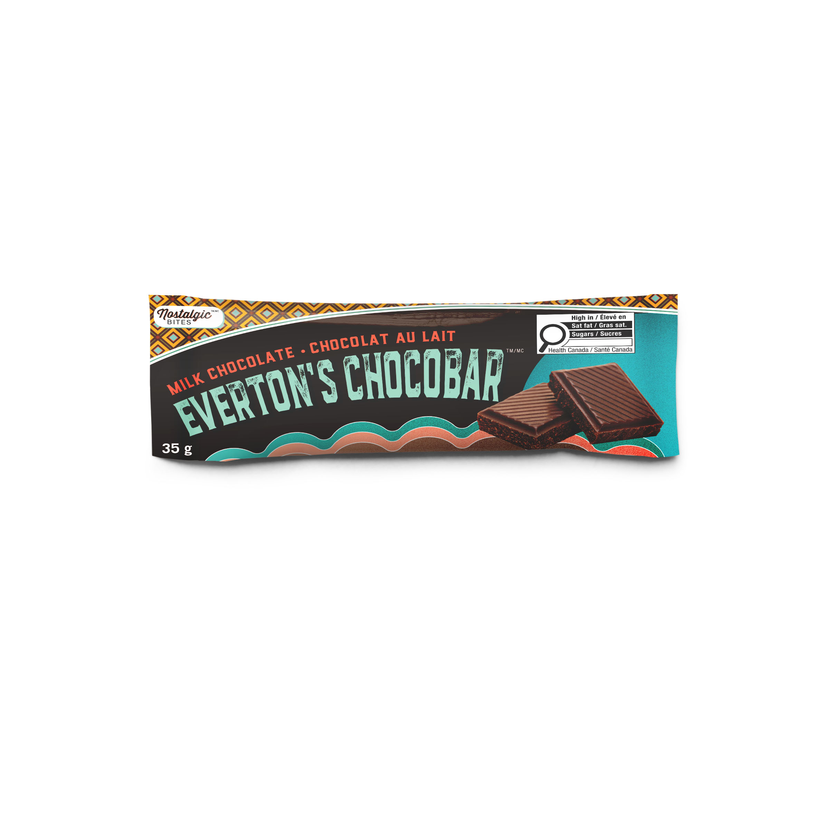
EXAMPLES

Slide 25
GUIDELINES
Generally if one of the nutrients is more than 15% Daily Value then a front of pack symbol will be needed
Small serving sizes under 30g/30ml the trigger is 10% Daily Value
Prepackaged main meals over 200g the trigger is 30% Daily Value

Slide 26
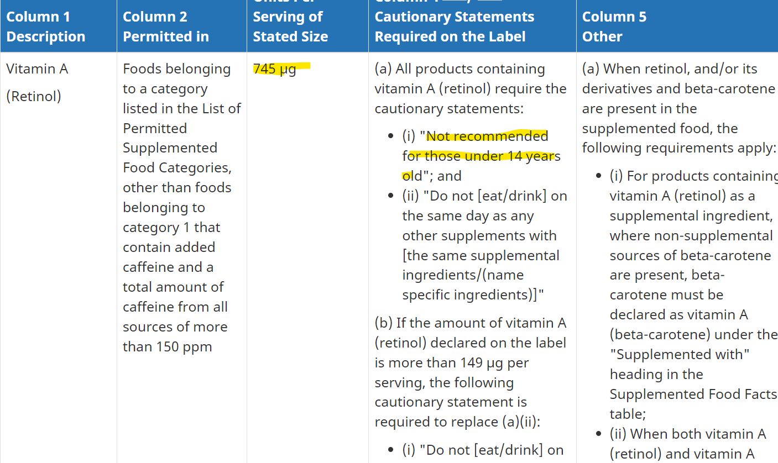
SUPPLEMENTED FOOD CATEGORY
A new category to bring fortified / supplemented foods out of the Natural Health Product category.
Rules about maximum amounts, classes of allowed foods and cautionary statements:

Slide 27
BRUCE MARSHALL
Nutrilytical
bruce.marshall@nutrilytical.ca

